Slide 1
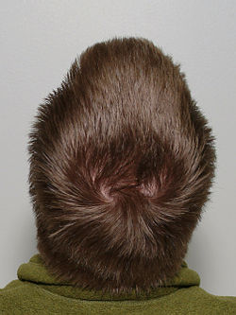
The scalp
Assitant lecturer
Dr. Hala Abbas
Second stage/ dentisry college

Slide 2
scalp
The scalp consists of five layers, the first three of which are bound together and move
as a whole on the skull.
The first letter of each layer combines to spell SCALP.

Slide 3
scalp
Skin which is thick and hair bearing and contains numerous sebaceous glands.
Connective tissue of the superficial fascia beneath the skin, which is fibrofatty.
Aponeurosis (epicranial) which is a thin, tendinous sheet that unites the occipital and frontal bellies of the occipitofrontalis muscle
Loose areolar tissue which occupies the subaponeurotic space
Pericranium which is the periosteum covering the outer surface of the skull bones.

Slide 4
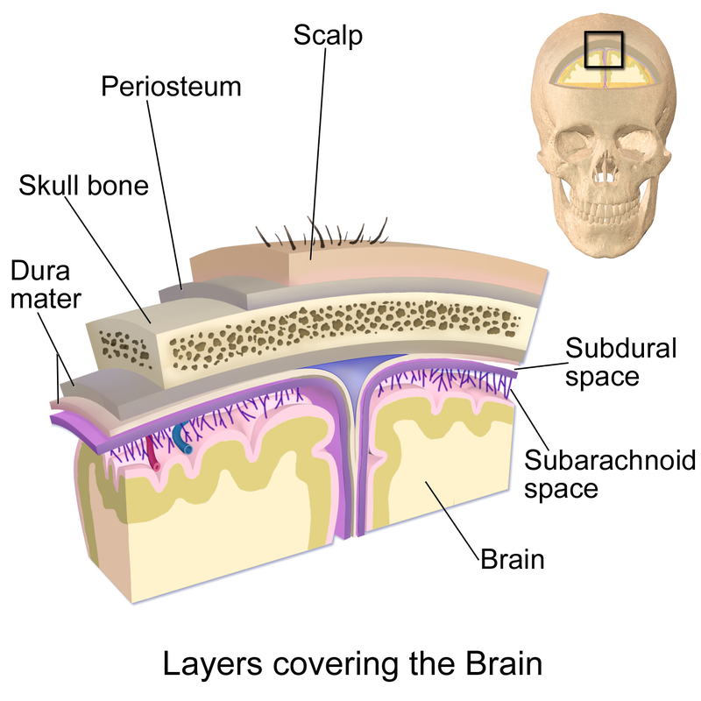

Slide 5
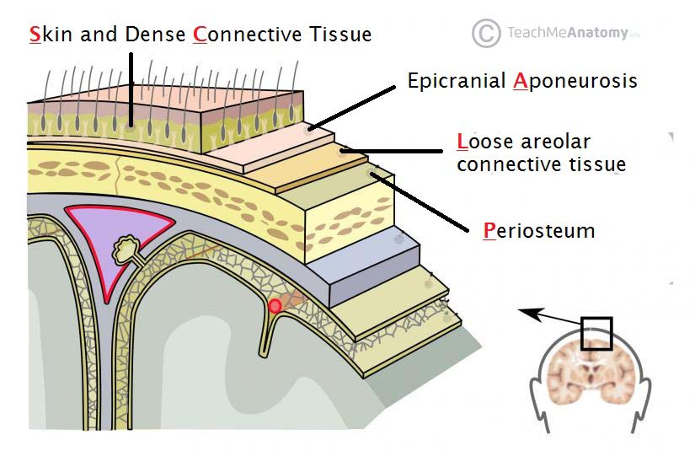

Slide 6
Muscles of the Scalp
Occipitofrontalis:
The origin, insertion, nerve supply, and action of this muscle are
described in the following Table.

Slide 7
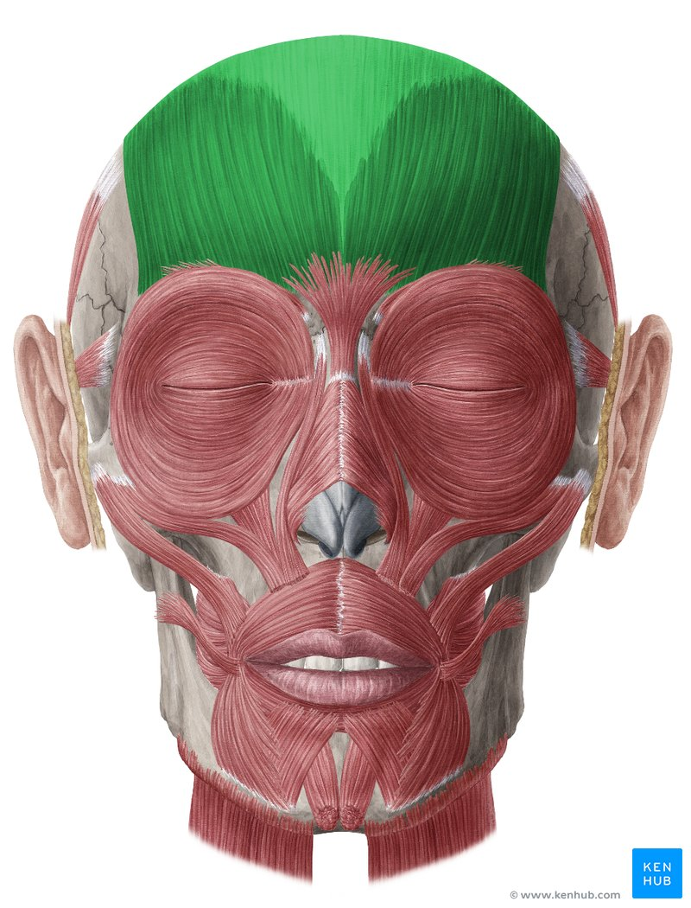

Slide 8
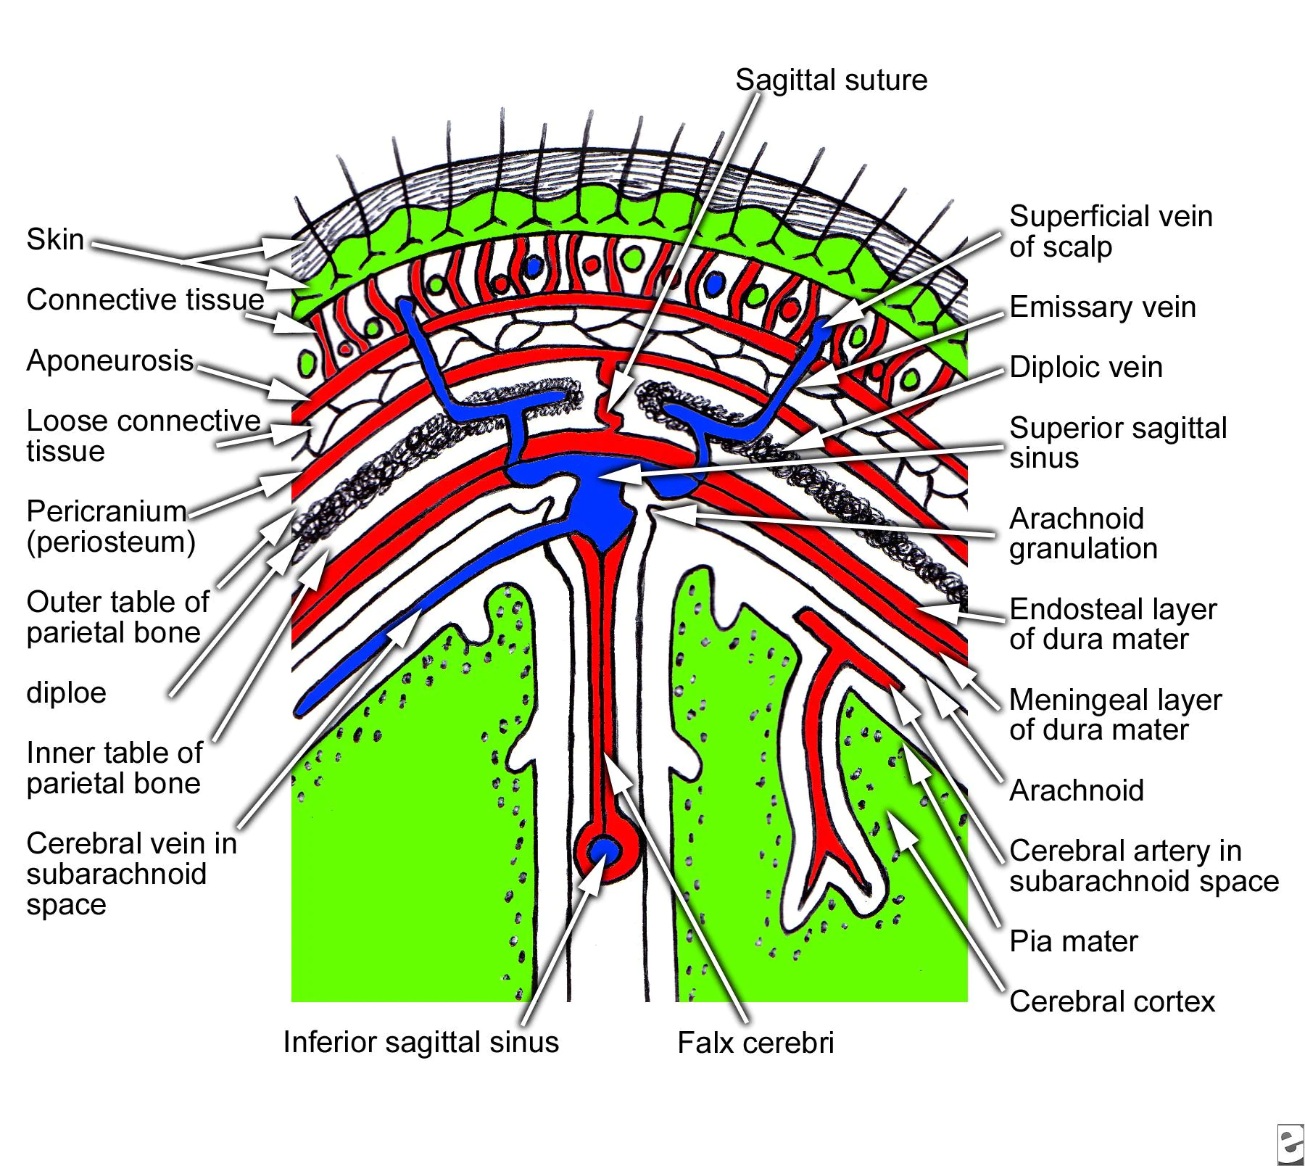

Slide 9
Sensory Nerve Supply of the Scalp
The main trunks of the sensory nerves lie in the superficial fascia. The following nerves are present (Fig. 3):
The supratrochlear nerve, a branch of the ophthalmic division of the trigeminal nerve, winds around the superior orbital margin and supplies the scalp. It passes backward and reaches the vertex of the skull.
The supraorbital nerve, a branch of the ophthalmic division of the trigeminal nerve, winds around the superior orbital margin and ascends over the forehead. It supplies the scalp as far backward as the vertex.
The zygomaticotemporal nerve, a branch of the maxillary division of the trigeminal nerve, supplies the scalp over the temple.

Slide 10
Sensory Nerve Supply of the Scalp
The auriculotemporal nerve, a branch of the mandibular division of the trigeminal nerve, ascends over the side of the head from in front of the auricle.
The lesser occipital nerve, a branch of the cervical plexus (C2), supplies the scalp over the lateral part of the occipital region and the skin over the medial surface of the auricle.
The greater occipital nerve, a branch of the posterior ramus of the 2nd cervical nerve (C2), ascends over the back of the scalp and supplies the skin as far forward as the vertex of the skull.

Slide 11
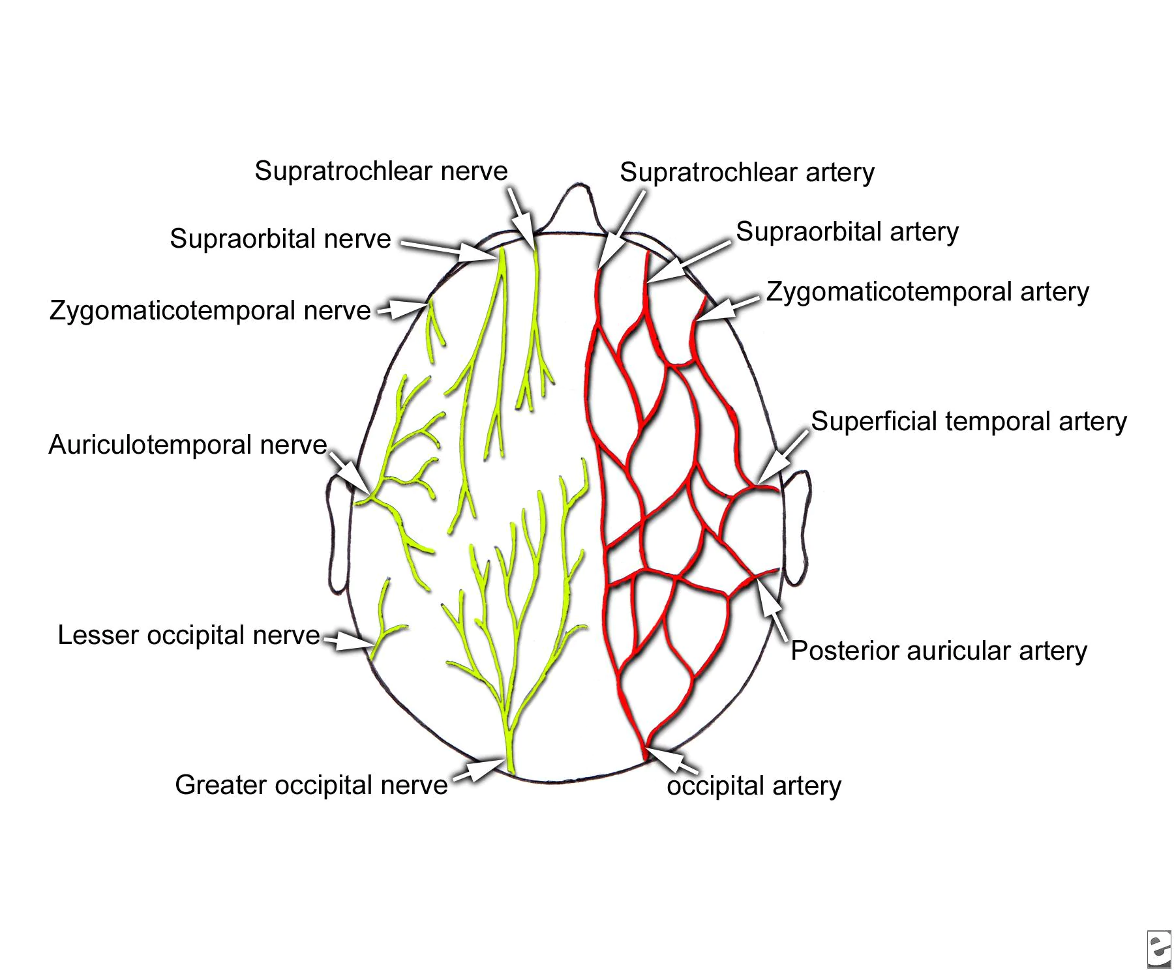

Slide 12
Arterial Supply of the Scalp
The scalp has a rich supply of blood to nourish the hair follicles, and, for this reason, the smallest cut bleeds profusely. The arteries lie in the superficial fascia.
The supratrochlear and the supraorbital arteries, branches of the ophthalmic artery, ascend over the forehead in company with the supratrochlear and supraorbital nerves.
The superficial temporal artery, a branch of the external carotid artery, ascends in front of the auricle in company with the auriculotemporal nerve. It divides into anterior and posterior branches, which supply the skin over the frontal and temporal regions.

Slide 13
Arterial Supply of the Scalp
The posterior auricular artery, a branch of the external carotid artery, ascends behind
the auricle to supply the scalp above and behind the auricle.
The occipital artery, a branch of the external carotid artery, ascends in company with
the greater occipital nerve. It supplies the skin over the back of the scalp and reaches
as high as the vertex of the skull.

Slide 14
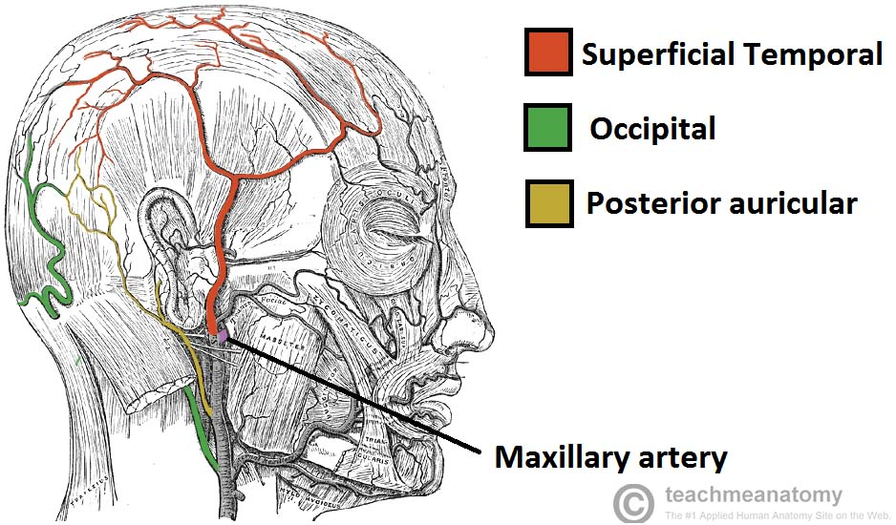

Slide 15
Venous Drainage of the Scalp
The supratrochlear and supraorbital veins unite at the medial margin of the orbit to form the facial vein. The superficial temporal vein unites with the maxillary vein in the substance of the The posterior auricular vein unites with the posterior division of the retromandibular vein, just below the parotid gland, to form the external jugular vein .
The occipital vein drains into the suboccipital venous plexus, which in turn drains into the vertebral veins or the internal .

Slide 16
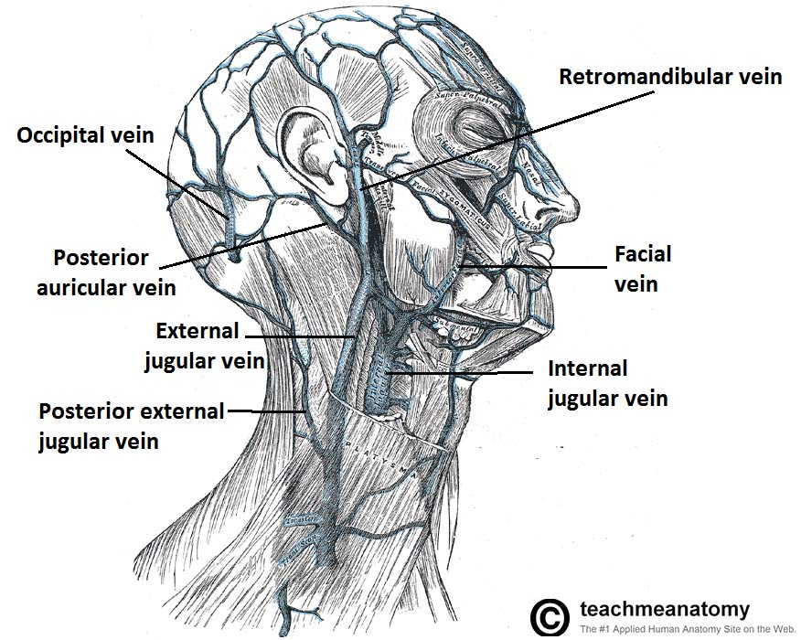

Slide 17
Lymph Drainage of the Scalp
Lymph vessels in the anterior part of the scalp and forehead drain into the submandibular lymph nodes
Drainage from the lateral part of the scalp above
the ear is into the superficial parotid preauricular) nodes;
lymph vessels in the part of the scalp above and behind the ear drain into the mastoid nodes. Vessels in the back of the scalp drain into the occipital nodes.

Slide 18
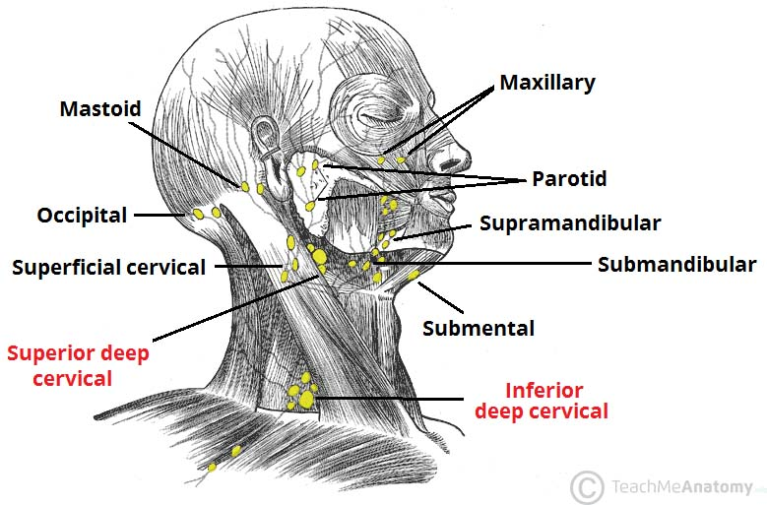

Slide 19
Clinical Notes and significance
The skin of the scalp possesses numerous sebaceous glands, the ducts of which are prone to infection and damage by combs. For this reason, sebaceous cysts of the scalp are common.
Even a small laceration of the scalp can cause severe blood loss. It is often difficult to stop the bleeding of a scalp wound because the arterial walls are attached to fibrous septa in the subcutaneous tissue and are unable to contract or retract to allow blood clotting to take place. Local pressure applied to the scalp is the only satisfactory method of stopping the bleeding. Infections of the scalp tend to remain localized and are usually painful because of the abundant fibrous tissue in the subcutaneous layer. Occasionally, an infection of the scalp spreads by the emissary veins, which are valveless, to the skull bones, causing osteomyelitis. Infected blood in the diploic veins may travel by the emissary veins farther into the venous sinuses and produce venous sinus thrombosis. Furthermore, blood or pus may collect in the potential space beneath the epicranial aponeurosis. It tends to spread over the skull.

Slide 20
Thank you

